Slide 1
INTEGRATING IPFS & ELK STACK FOR RESILIENT AND QUERYABLE DATA STORAGE OVER EDGE AND FOG
By Akshat Kumar (S.R-19868) and Jeet Ahuja Mukesh kumar(S.R-19703)

Slide 2
Introduction
In IoT applications the data collected from an array of sensors is analysed and decisions are made within few seconds to control the system.
As of late, edge devices are being widely deployed, because they help gather and transmit observations from the sensors, and to enact control decisions. This has resulted in a lot of data, especially time-series data.
Although, TSDBs like InfluxDB are popular choices for hosting such data from sensors and perform temporal queries on the data an these TSDBs reside on the cloud.
Since the sensors producing this data and the application consuming this data tend to reside close to the edge devices, sending every query to the central cloud can incur significant latency which is an important factor to consider.
Also, we lose a lot of compute and storage potential in terms of the resources available on the edge and fog devices themselves.

Slide 3
Background and Related Work
This afore-mentioned issues motivates gives us the motivation to develop an efficient storage and querying system that resides right on the edge and fog devices.
The above discussed motivation is where TorqueDB developed by Dhruv Garg, et al. comes in handy. It leverages ElfStore distributed edge local storage and InfluxDB to offer distributed time-series querying over the edge and fog devices.
We intend to make changes to these leverages by replacing ElfStore with IPFS and use ElasticSearch (ELK Stack) as an indexing mechanism in an effort to improve the efficiency and usability of the database.

Slide 4
Problem definition
The focus of this project is to integrate IPFS and ELK stack to get a powerful distributed data storage platform.
First, we focus on integrating IPFS with ELK stack on a per-node basis to get the basic functionality through.
The data to be stored in IPFS must be indexable using various fields for better query ability.
Once this is done, we shall expand this to a more distributed multi-node system (using IPFS cluster API)

Slide 5
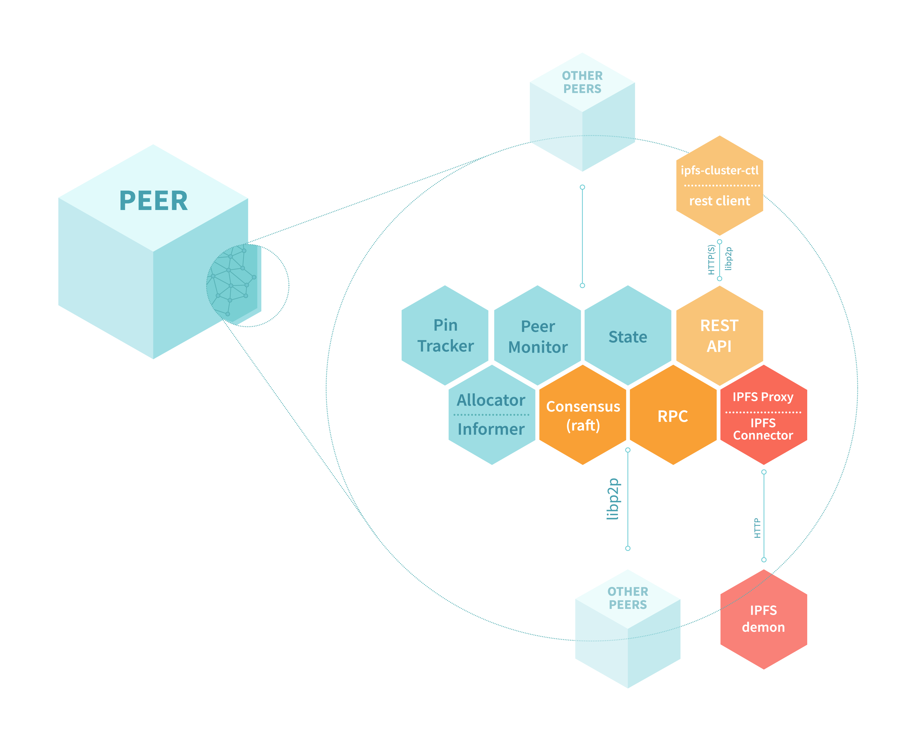
About the technologies to be used:
IPFS
The Interplanetary File System is a protocol and peer-to-peer network for storing and sharing data in a distributed file system.
A content addressed storage is employed by IPFS. i.e., for accessing data through IPFS, contents of data is being, instead of location-based addressing.
The mechanism is like BitTorrent. Instead of having a centrally located server, IPFS is built around a decentralized system of multiple host-operator nodes where each node holds a part of the total data, resulting in a resilient system of file storage and sharing.
Any node in the network can serve the required file using the content as an address, and other peers can find and request that content from any host having that content using Distributed Hash Table.

Slide 6
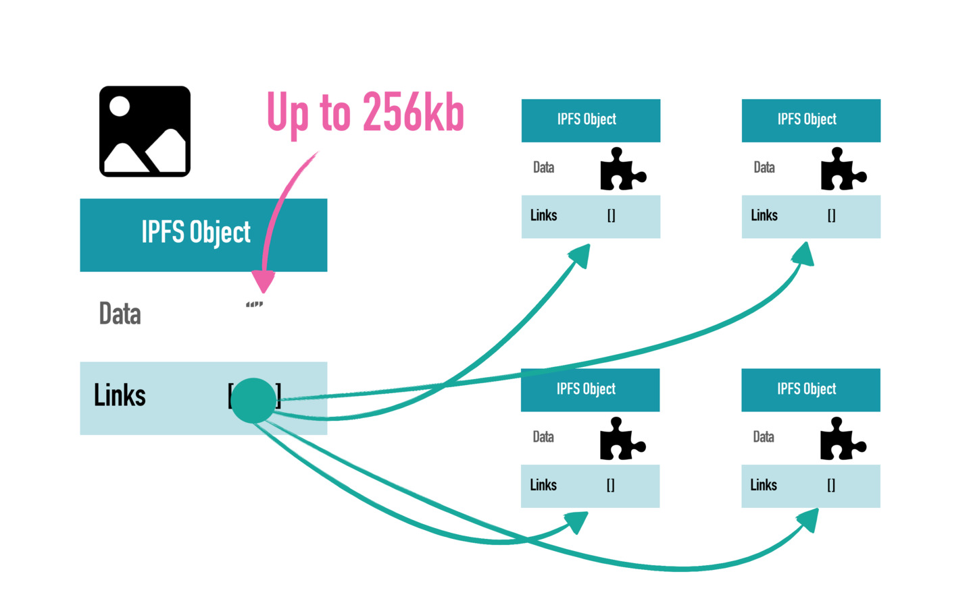
About the technologies to be used: (Contd.)
All files in the IPFS system are stored as so-called IPFS objects. Each object has a space limit where it can only store up to 256 KBs of data. In addition to the 256 KBs of data, each object can store links that refer to other IPFS objects.
If we have a file that is greater than 256 KBs worth of data, the InterPlanetary File System splits the file and divides it into several different objects that do not exceed the 256 KB limit. Once the file is split, the system creates one more empty object that links to all objects containing the data.
IPFS makes use of merkle DAGs, where each node will be having a unique identifier called CID that is a hash of the node’s contents.

Slide 7
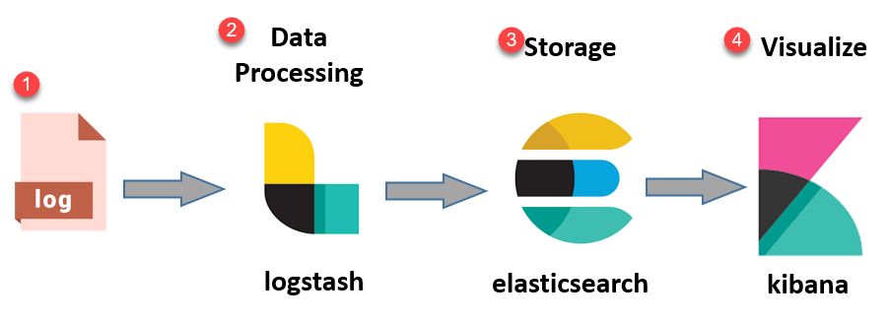
About the technologies to be used: (Contd.)
ELK Stack:

Slide 8
About the technologies to be used: (Contd.)
Elastic-Search
Elasticsearch is distributed, open-source search and analytics engine built using Apache Lucene and developed in Java.
Elasticsearch allows us to store, search and analyze huge volumes of data quickly and efficiently by searching the text directly. (claimed max time of 1 second over very large datasets)
In simpler terms, we can think of Elasticsearch as a server that receives JSON requests and gives back JSON data, all of it being leveraged with extensive REST APIs.
It uses inverted index. i.e., a HashMap-like data structure that directs from a word to a document. Elastic search distributes the tasks of searching and indexing across all the nodes in the cluster.
In our case Elastic search indexes based on the metadata. And when a client queries, the searching is done based on the meta-data. First step will be to identify using elastic search the storage block id using the meta-data requested.

Slide 9
About the technologies to be used: (Contd.)
Logstash
It is a data processing pipeline used to process data on the fly and send it to the required destination.
It helps us obtain data in required format from a variety of different filetypes.
This is a very useful tool to extract information even if data is unstructured by making use of a variety of supported filter APIs and native regex support.
In context of our project, we shall be using it to push metadata in bulk to the Elastic server.
The json filter will help us maintain the keys as searchable fields inside Elasticsearch.

Slide 10
Kibana
It is a front end application that fits on top of ELK stack.
It helps with visualization of the data indexed by Elastic search.
It also provides KQL aka Kibana query language which helps with querying over the data stored in indices and obtain necessary information.
It shall be a useful tool for us in future as a centralized portal to view all Elasticsearch indices across the multitude of nodes.

Slide 11
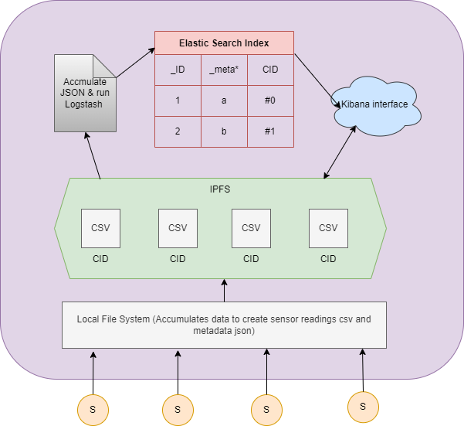
Proposed per-node architecture:
Sensors send data to the edge device.
Edge device accumulates and creates time-sized (preferably) csv files of the info gathered on the local file system and also generates required metadata.
Then the csv’s are unserted into IPFS and the generated CIDs are appended to metadata as they help in retrieving the blocks using IPFS’s API calls.
The we agglomerate all metadata into one single json and push it with Logstash json filter into Elastic search where it is indexed.
We an then perform basic queries on data via ELC CLI or Kibana WebUI

Slide 12
Approach:
We shall be solving the above stated problem in the following stages:
Study IPFS.
Study ELK Stack.
Find a way to package metadata into a common file.
Figure out a configuration to index these metadata using elastic-search and store as key-value pairs.
Query planning in terms of fields produced by Elastic-Search.
Scale this mechanism to distributed system.(Pending)
Integrate the ES+IPFS into torqueDB after decoupling ElfStore. (Pending)

Slide 13
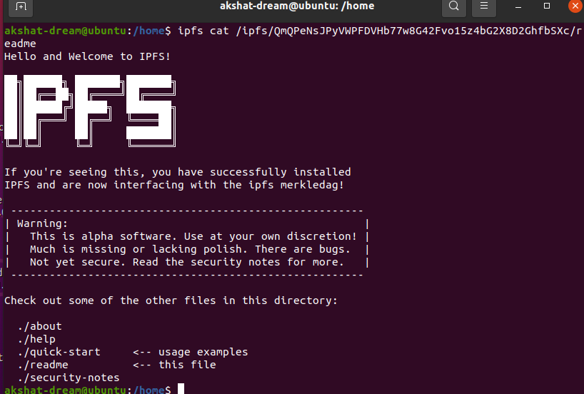
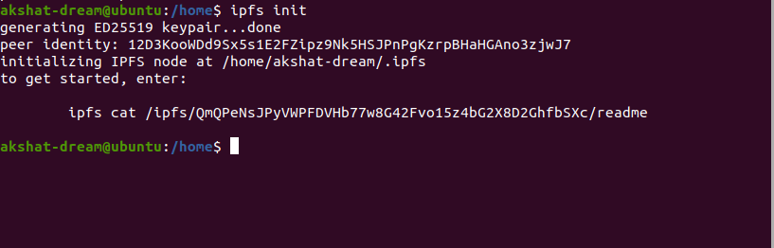
Experimental runs:
Initializing IPFS using init call and adding key to authenticate node on IPFS.

Slide 14
Experimental runs:
Initializing IPFS using init call and adding key to authenticate node on IPFS.

Slide 15
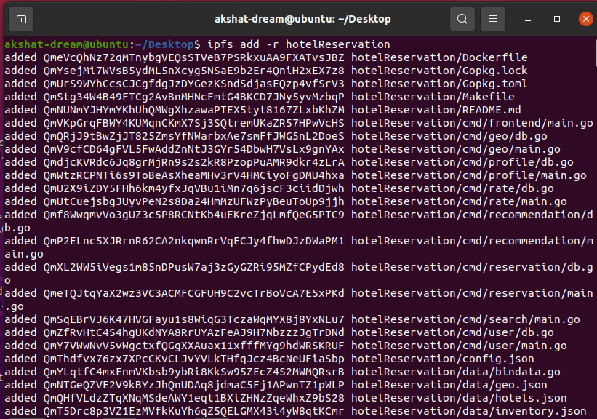
Experiments(Contd.)
Adding files recursively into IPFS node using default pinnings.

Slide 16
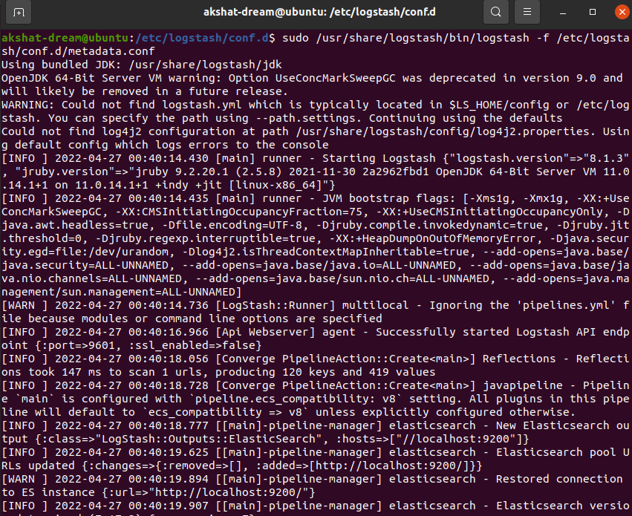
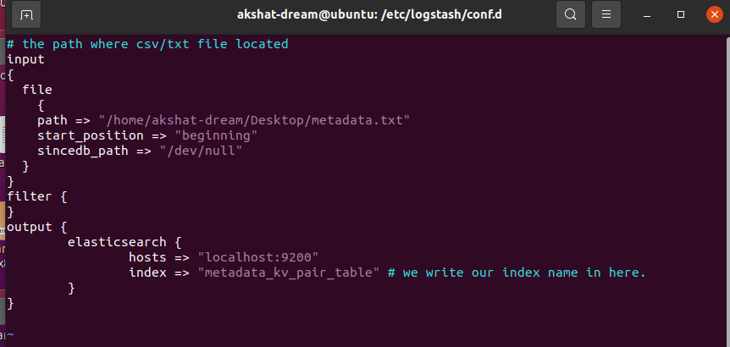
Experiments(Contd.)
Configure logstash using the conf file in-order to push metadata into the elastic search server in order to index it in for of key value pair.

Slide 17
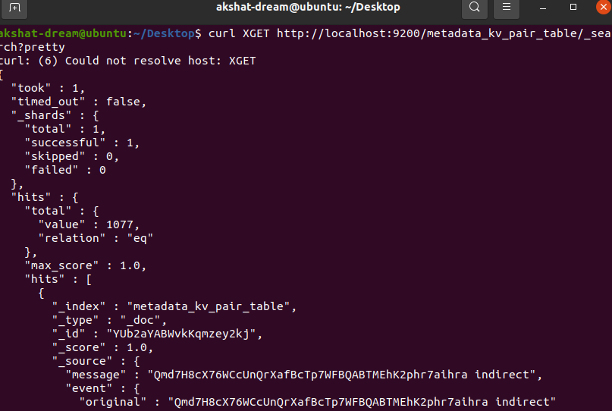
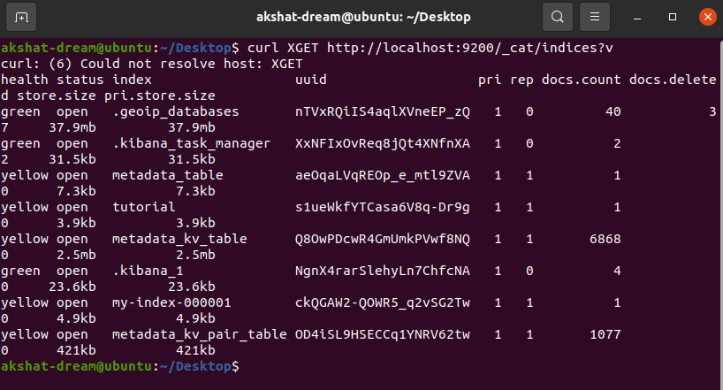
Experiments(Contd.)
Verify if files have been inserted and indexed.

Slide 18
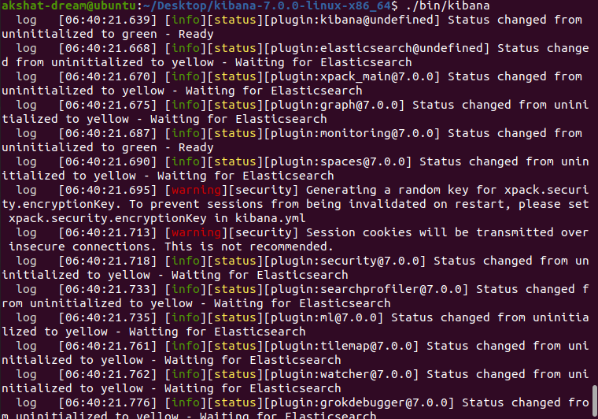
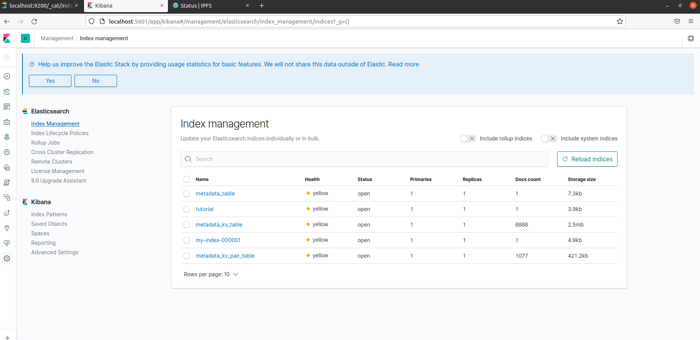
Experiments(Contd.)
Launch Kibana via webui or cli inorder to modify or check indexing pattern if needed.

Slide 19
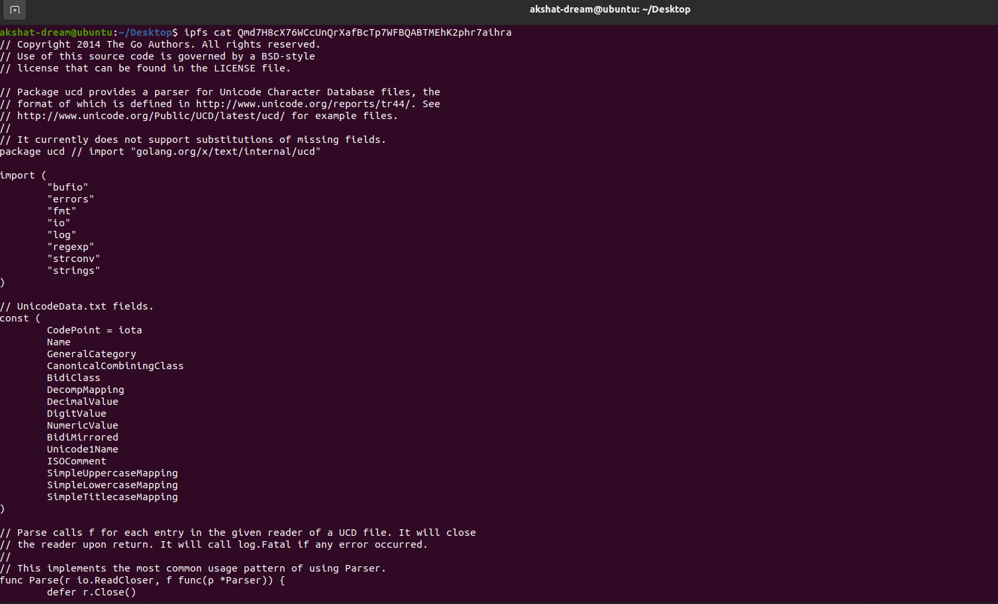
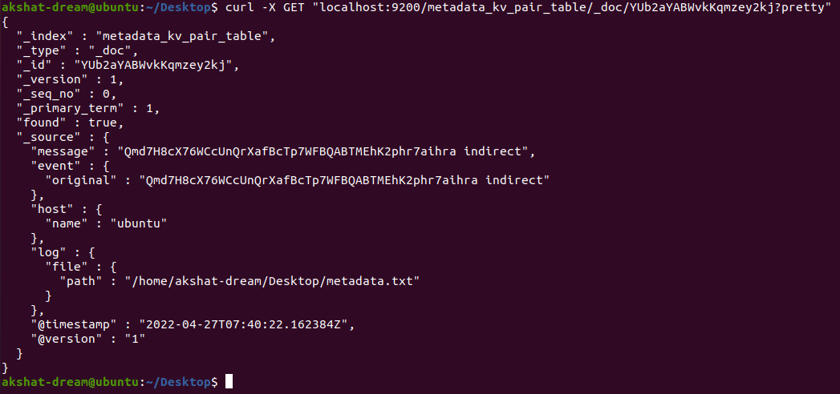
Experiments(Contd.)
We can now retrieve the metadata values of a file using the indexes of ElasticSearch via API call. The obtained Hash for the index can be used to retrieve files from IPFS Server using IPFS API call.

Slide 20
Future work
Now that we have the basics down of how to integrate Elasticsearch with IPFS, we can try to move this to a more distributed system.
We shall then integrate this entire system in TorqueDB lite, a distributed database for time series querying that leverages on InfluxDB to process advanced queries over accumulated data.
The IPFS-ELK combination will provide a fast scalable and reliable file system to torqueDB in terms of storing data and finding required blocks as and when needed as per user queries.

Slide 21
Conclusion
IPFS comes across as a strong peer to peer based distributed file storage system with huge potential in Edge computing.
Elastic search provides a relatively easy mechanism for indexing files with support from Logstash in order to push the files into the server and Kibana provides a good playing ground to visualize and play around with indexing.
We shall hopefully be able to integrate this combination into TorqueDB and compare results with ElfStore mechanism in near future.

